Slide 1

Introduction
In the modern era of digital marketing, businesses leverage various advertising platforms to reach out to potential customers. Understanding the effectiveness of these campaigns is critical for optimizing marketing strategies and allocating budgets effectively. This project entails a comprehensive analysis of a marketing campaign dataset that spans multiple digital channels and services, including Facebook Ads, Google Ads, and DV360. The dataset encompasses various metrics such as budget allocation, clicks, impressions, and keyword performance, segregated by time and location.

Slide 2

Objective
The primary objective of this project is to derive actionable insights from the campaign data that can inform future marketing decisions. Specifically, the goals are to:
Assess the distribution and efficiency of budget spend across different advertising channels and external services.
Analyze the performance of specific keywords and creative strategies to understand customer engagement patterns.
Examine the variability in campaign impact by location to tailor geo-targeted advertising efforts.
Evaluate temporal trends in campaign interactions by analyzing clicks and impressions during weekdays and weekends.

Slide 3

Visualization

Slide 4

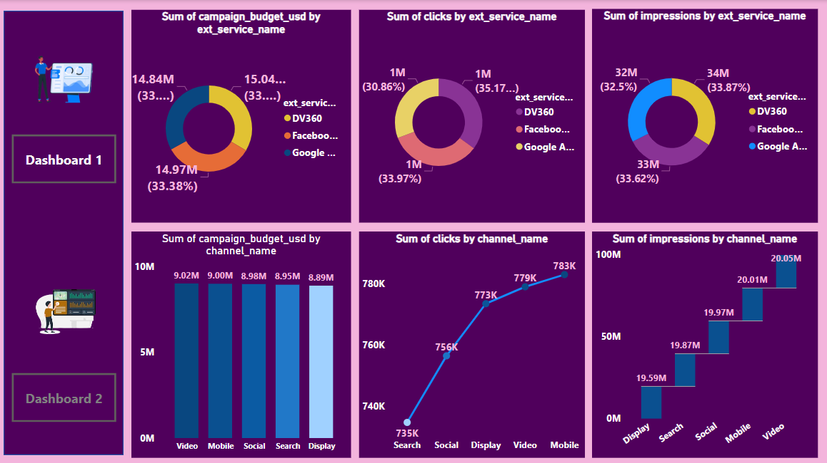
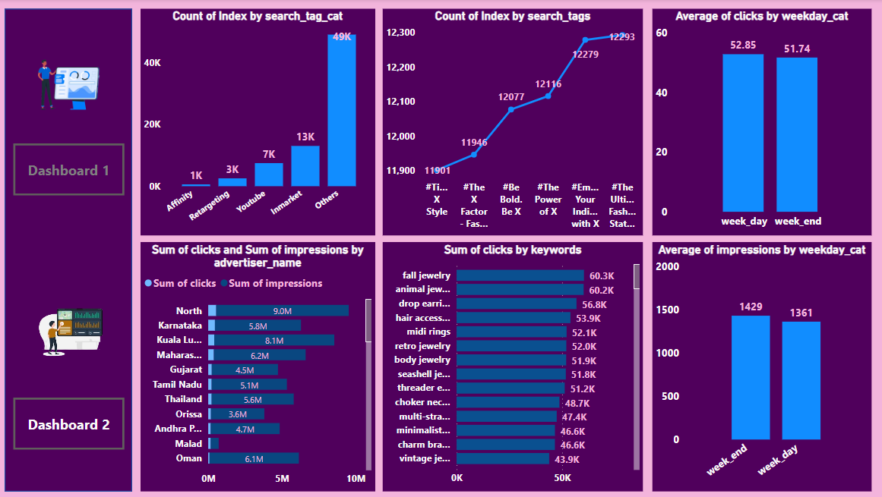
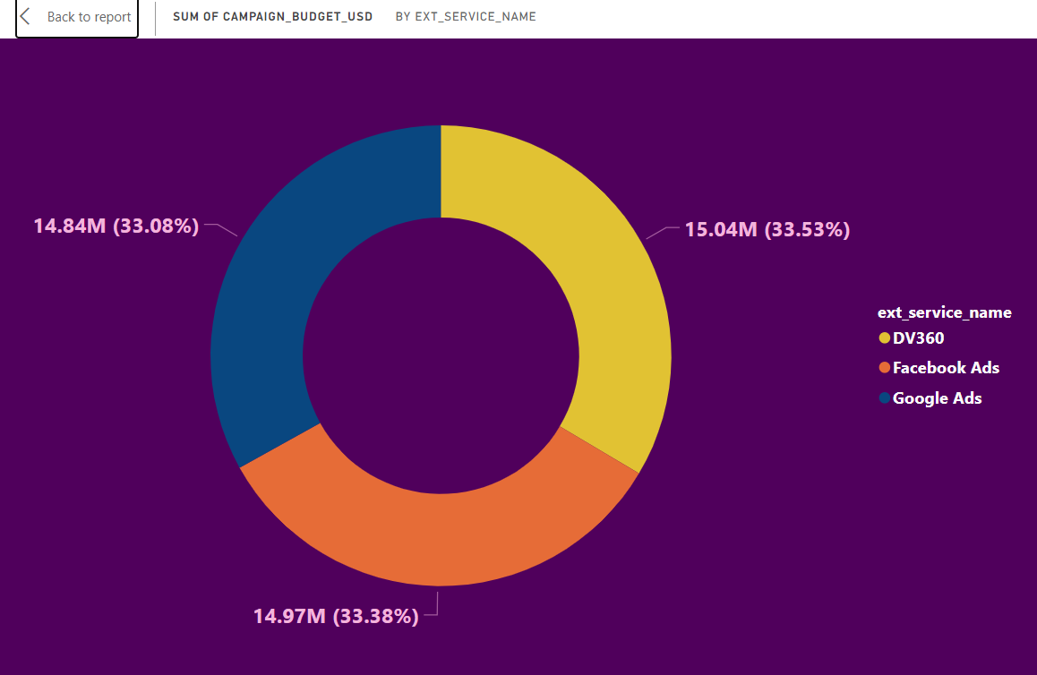
The dashboard appears to present data from a marketing campaign, broken down by different channels and external services. Here are two insights:
Campaign Budget Allocation: The budget is fairly evenly distributed across the channels, with Video receiving the highest budget (9.02M) and Display the least (8.89M). This indicates a balanced approach to channel investment.
Performance by External Service: Google Ads, DV360, and Facebook have similar shares across campaign budget, clicks, and impressions. However, Google Ads slightly leads in impressions, suggesting it might be the most effective platform for reach.
These observations could guide further analysis and optimization of channel spending and external service usage to improve the campaign's performance.

Slide 5

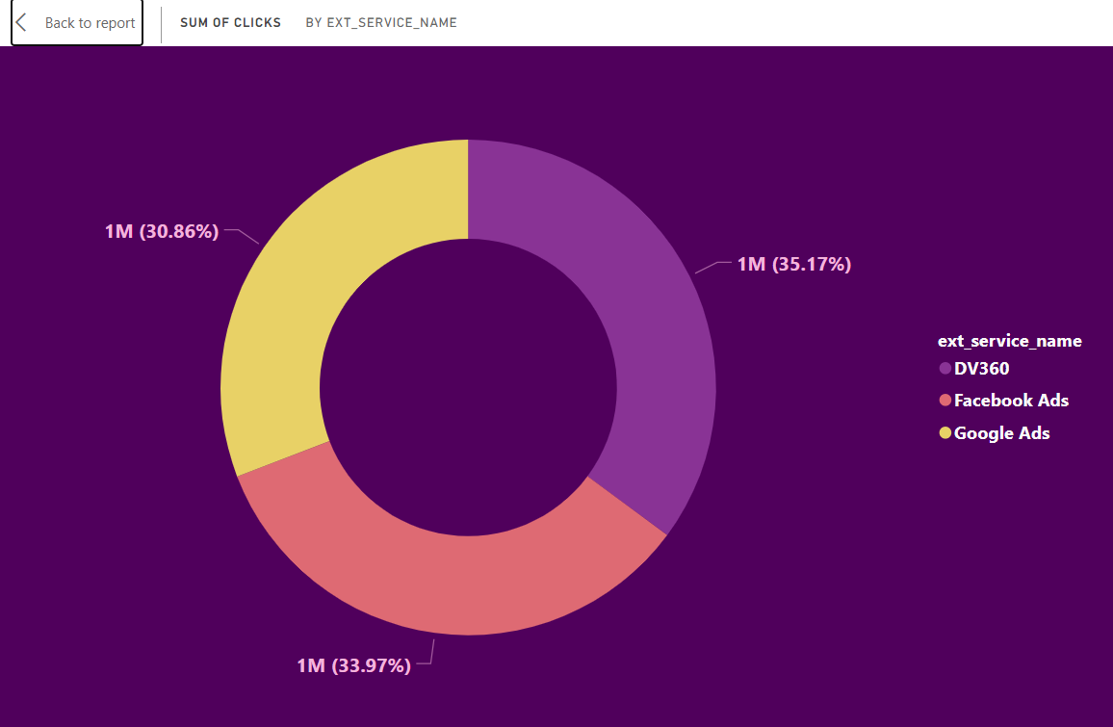
From the second dashboard, we can derive the following insights:
Search Tag Categories and Tags: The "Others" category in search tag categories significantly outperforms other categories like "Affinity" or "Retargeting". Additionally, within search tags, there's a very close competition among the top tags, with #TheXStyle and #TheBoldBeX being the most searched.
Clicks and Impressions: The North region leads in both clicks and impressions, suggesting that advertising efforts in this area are quite effective. For keyword-driven clicks, "fall jewelry" and "animal jewelry" are the top performers, indicating these are popular items.
Engagement is higher on weekdays for both clicks and impressions, which could inform when to concentrate ad spend for maximum impact.

Slide 6

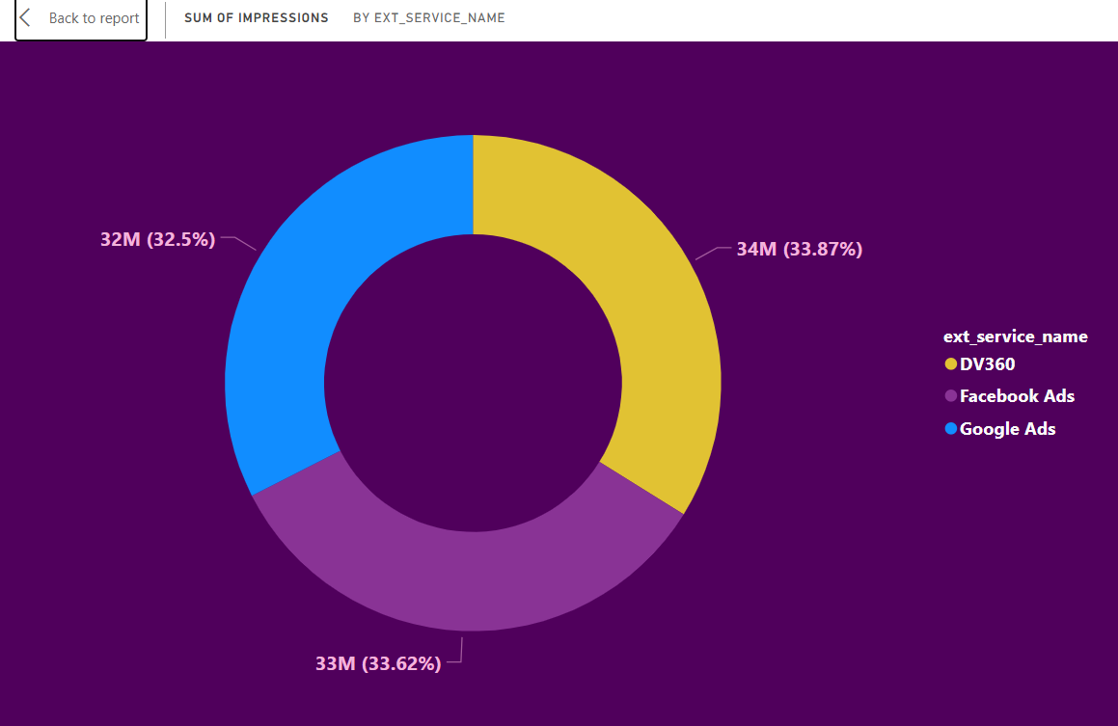
The donut chart shows a near-equal distribution of the campaign budget across three external services: DV360, Facebook Ads, and Google Ads, each claiming approximately one-third of the total budget. Google Ads has a marginally higher allocation, suggesting a slight preference or expectation of higher performance from that service.

Slide 7

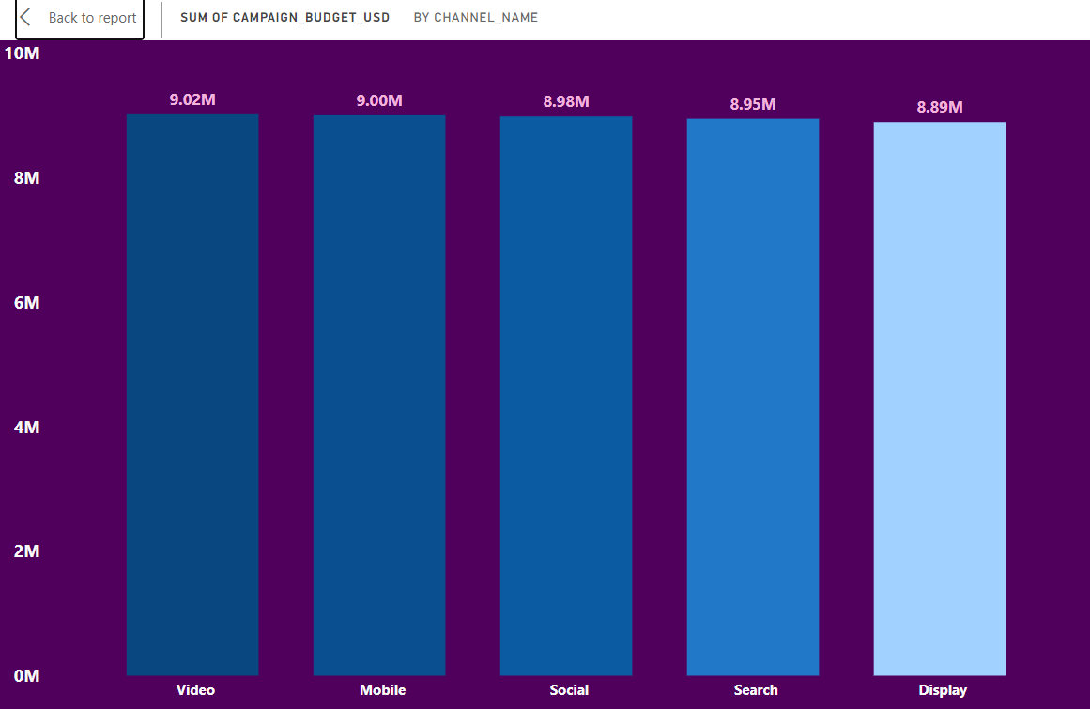
The chart displays clicks distribution across three advertising services: DV360, Facebook Ads, and Google Ads. Each service has generated 1 million clicks, with slight variations in percentages, indicating a fairly balanced performance in terms of click generation across platforms. Google Ads has a slight lead with 35.17% of the clicks.

Slide 8
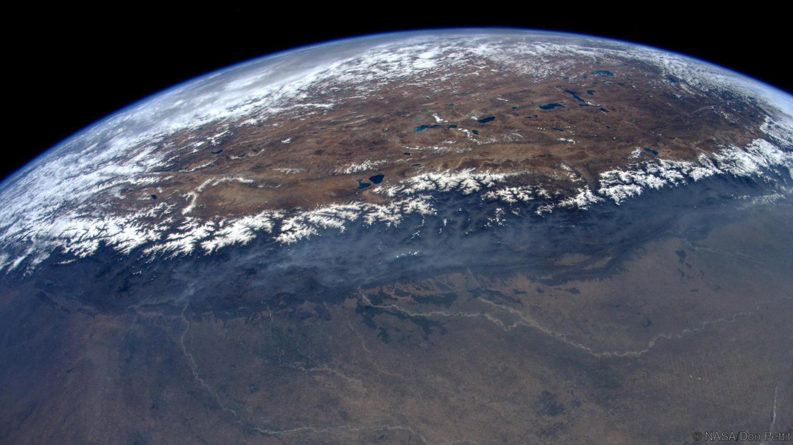
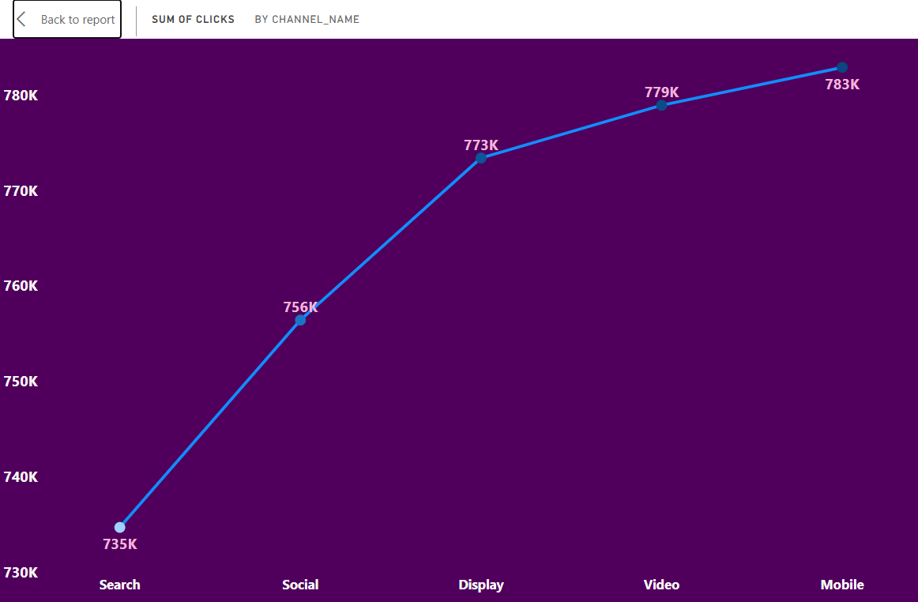
The donut chart presents the distribution of impressions among DV360, Facebook Ads, and Google Ads. Google Ads has the highest share with 34 million (33.87%) impressions, followed closely by Facebook Ads and DV360, suggesting a relatively balanced visibility across these platforms, with a slight edge for Google Ads in terms of reaching potential customers.

Slide 9

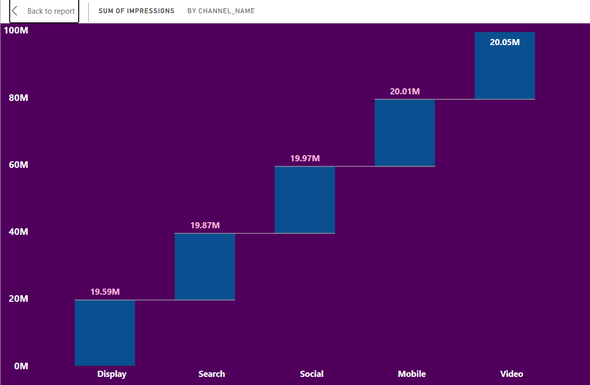
The bar chart shows the distribution of the campaign budget across five different channels: Video, Mobile, Social, Search, and Display. Video has the highest budget allocation at $9.02 million, while Display has the lowest at $8.89 million. The budget distribution is quite balanced, with all channels receiving close to $9 million, indicating a diversified approach to the campaign's channel strategy.

Slide 10

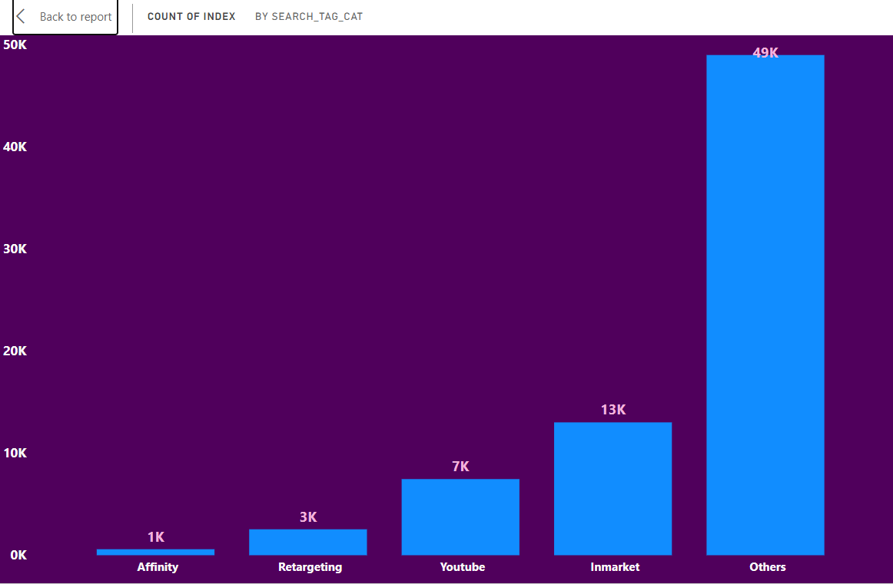
The line graph depicts the sum of clicks by channel, showing a progressive increase from Search to Mobile. Search has the lowest clicks at 735K, while Mobile leads with 783K clicks. This trend suggests a higher engagement with ads on mobile devices, potentially indicating user behavior favoring mobile browsing or the effectiveness of mobile-targeted campaigns.

Slide 11

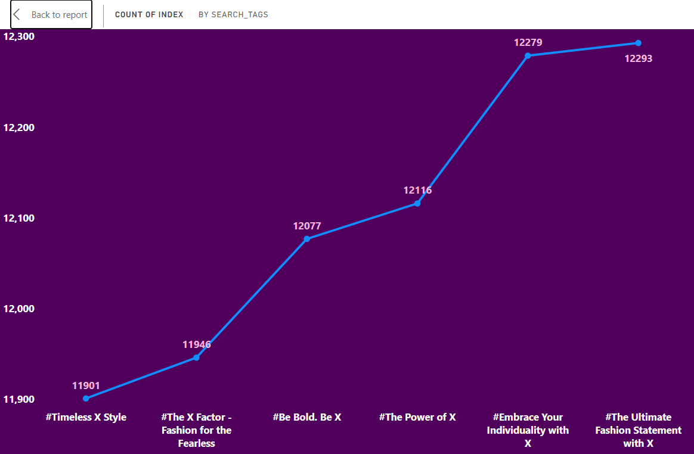
The bar chart presents the sum of impressions by channel. Video leads with the highest number of impressions at 20.05 million, indicating its strong reach potential. Mobile and Social channels follow closely, with 20.01 million and 19.97 million impressions respectively, suggesting a high engagement with content across these platforms. Display has the lowest at 19.59 million, but the differences between the channels are relatively minor, indicating a balanced distribution of visibility.

Slide 12

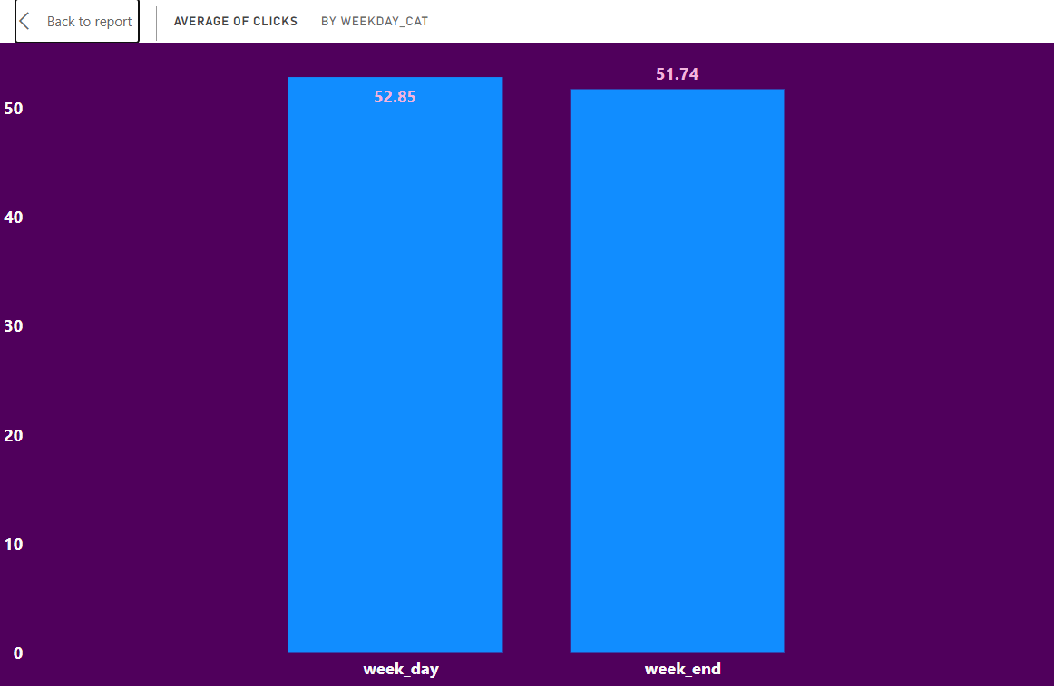
The bar chart shows the count of indices categorized by search tag categories. The "Others" category is the most prevalent, with a count of 49K, suggesting a wide variety of search terms outside the specified categories. Youtube has a relatively moderate count of 7K, while Affinity and Retargeting are the least common with 1K and 3K respectively. This indicates that search activity is diverse, and not confined to the predefined targeting categories like Affinity or Retargeting.

Slide 13

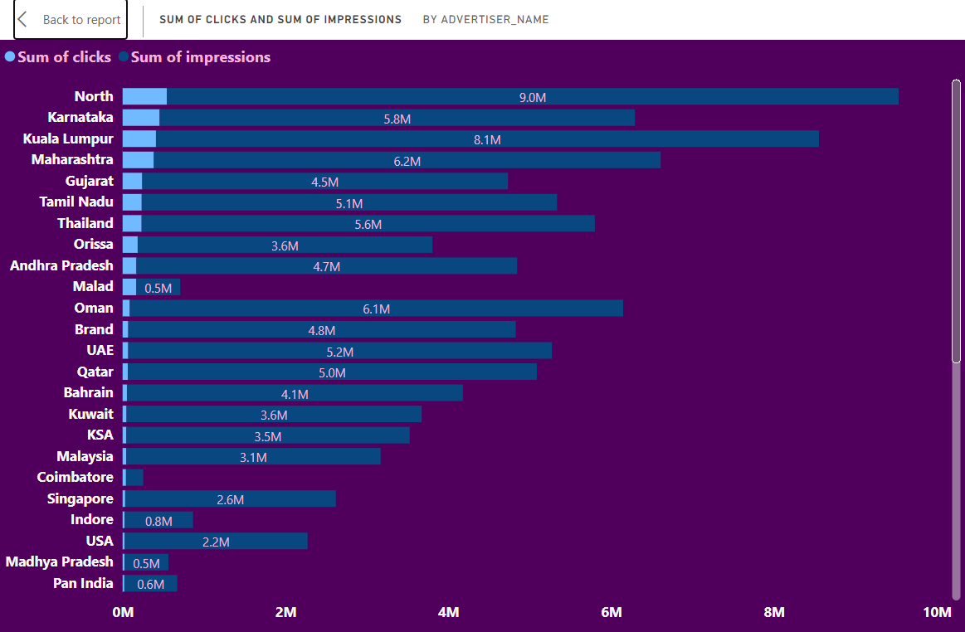
The line graph illustrates the count of indices by search tags. The tags show an increasing trend, with "#TheUltimateFashionStatement with X" having the highest count at 12,293, indicating this tag is the most popular or most searched. The tag "#Timeless X Style" has the lowest count at 11,901. The growth between consecutive tags is relatively steady, suggesting a consistent interest across different tag themes.

Slide 14
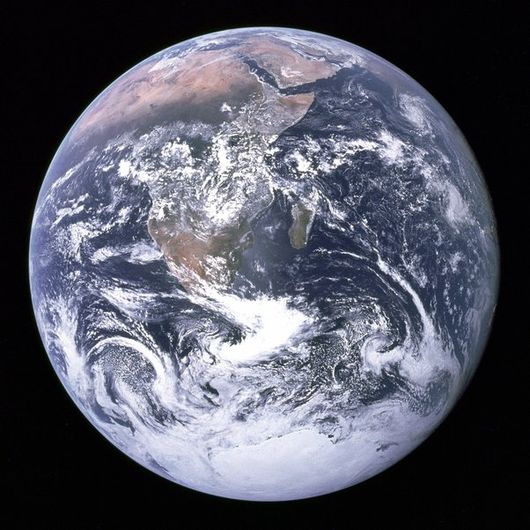
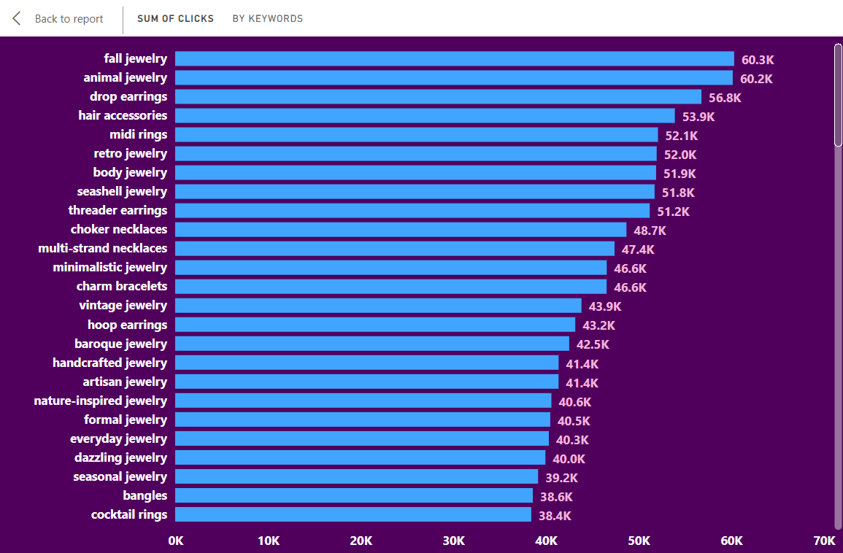
The bar chart compares the average number of clicks between weekdays and weekends. The average clicks on weekdays are slightly higher, at 52.85, compared to 51.74 on weekends. This could indicate that users are marginally more active or more likely to click on ads during the weekdays.

Slide 15

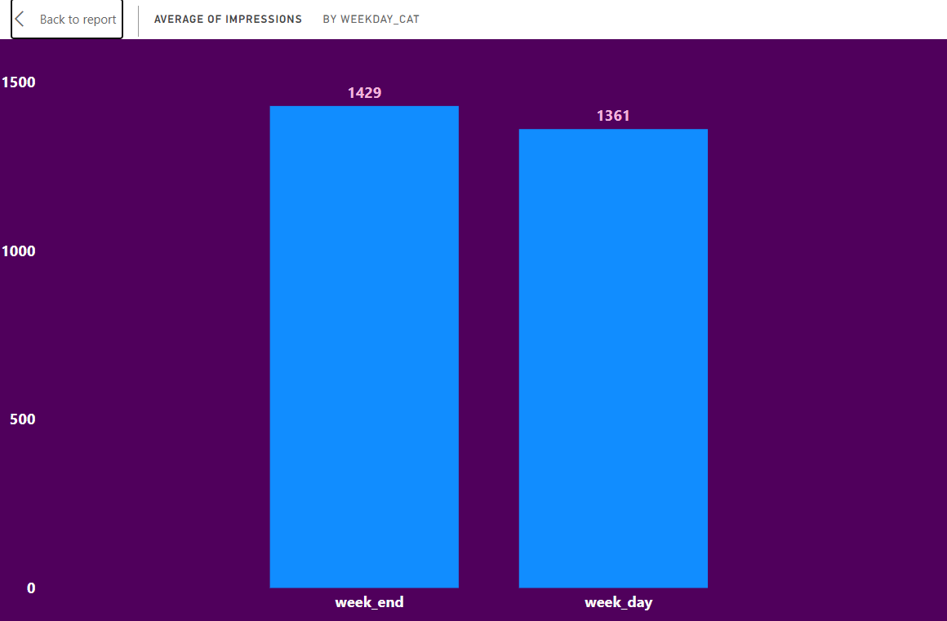
The bar chart compares the sum of clicks and the sum of impressions across various locations, likely representing different advertising segments or targets. Here are some observations:
North Region Performance: The North region leads significantly in both clicks and impressions, with the highest count at 9 million impressions and the largest number of clicks among the listed locations.
High Impressions with Fewer Clicks: Several regions like Karnataka, Kuala Lumpur, and Maharashtra have a high number of impressions (above 5 million) but comparatively fewer clicks, indicating the ads are seen frequently but may have a lower click-through rate.
The data could suggest that certain regions respond better to ads, or it might highlight the effectiveness of targeted advertising in those regions. The discrepancies between clicks and impressions could be an opportunity to optimize ad engagement strategies.

Slide 16

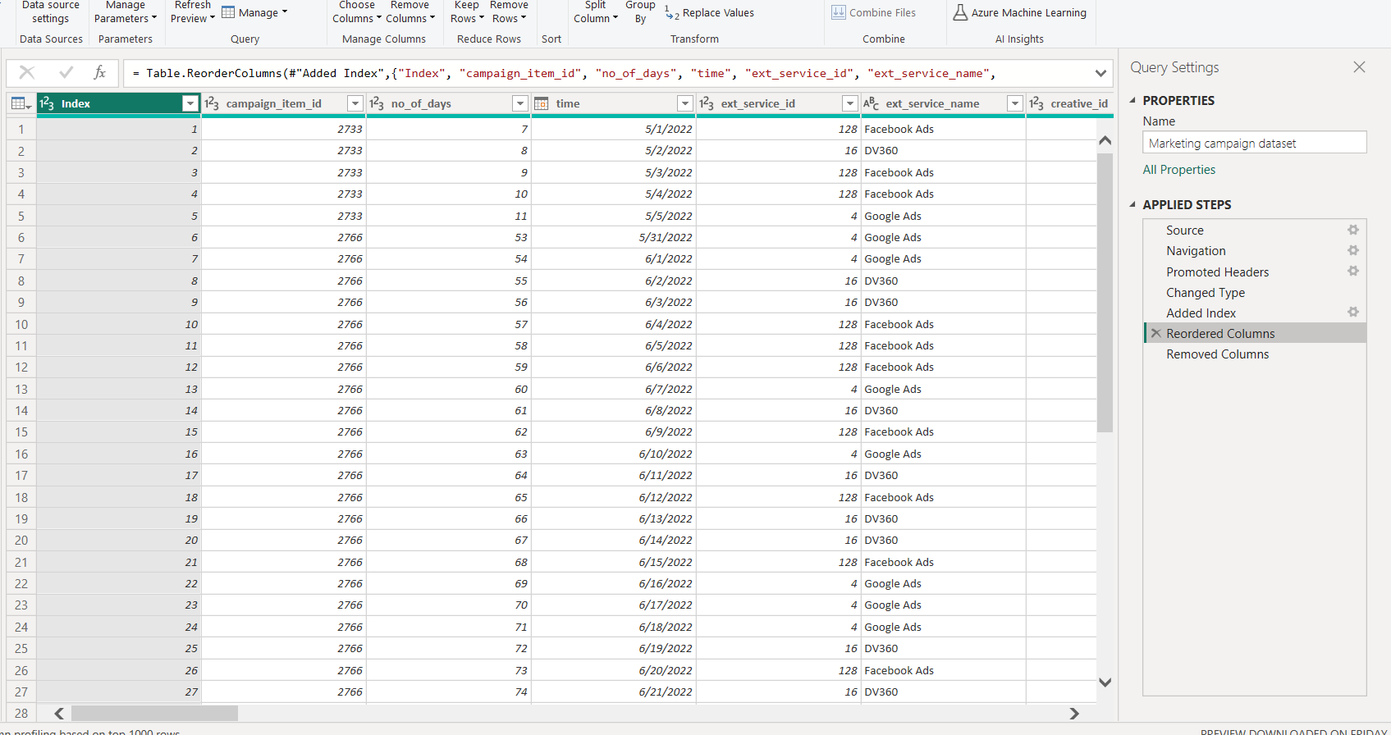
The bar chart displays the sum of clicks by keywords related to jewelry. "Fall jewelry" and "animal jewelry" are the top-performing keywords with 60.3K and 60.2K clicks respectively, indicating high interest or effectiveness in these categories. The clicks gradually decrease for other keywords, with "cocktail rings" receiving the least amount of clicks at 38.4K. This information could be used to focus on high-performing keywords in future campaigns and explore why certain items like "fall jewelry" are resonating with the audience.

Slide 17
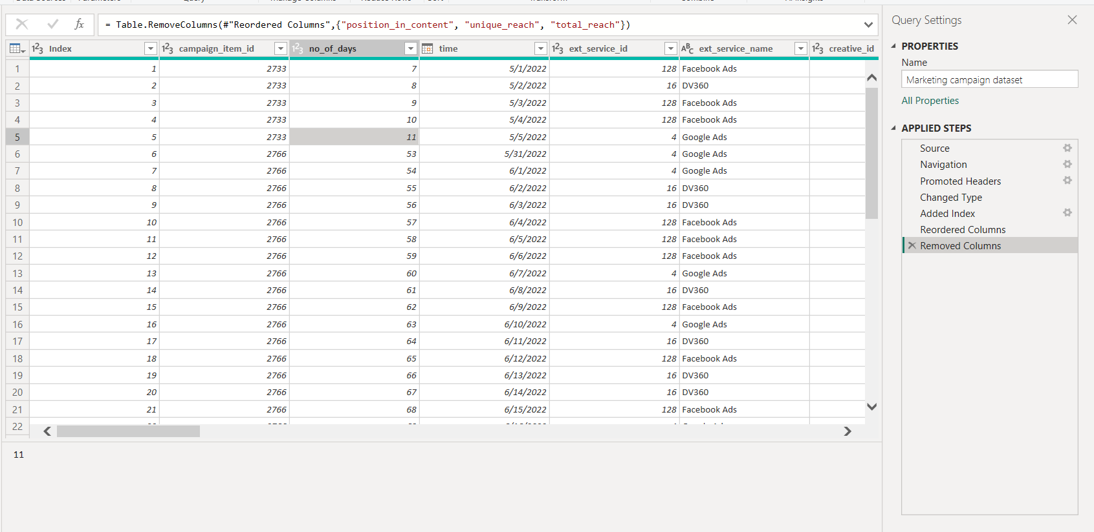
The bar chart shows the average number of impressions by weekday categories. It indicates that the average number of impressions on weekends is slightly higher at 1429 compared to 1361 on weekdays. This suggests that ads may be slightly more visible or there is slightly higher user activity during weekends.

Slide 18

Its about adding index column with power query

Slide 19

Its about removing some columns has no values

Slide 20

Conclusion
The analysis of the marketing campaign data has provided several key insights:
The campaign budget is evenly distributed among various channels, with Video receiving a marginally higher share. Each external service (DV360, Facebook Ads, Google Ads) received a substantial and nearly equal portion of the budget, with Google Ads getting a slightly larger allocation.
Clicks and impressions were comparable across services, but Google Ads showed a slightly higher performance in terms of impressions, which may indicate a broader reach.
There is a higher engagement on mobile devices, as evidenced by the number of clicks, and the impressions were relatively balanced across all channels, with Video leading slightly.
User engagement with ads is slightly higher on weekdays, suggesting a potential focus for timing campaign intensification.
Keywords related to 'fall jewelry' and 'animal jewelry' garnered the most clicks, suggesting high interest in these areas.
The campaign demonstrates a strong multi-channel presence, with a balance between reach and engagement. The insights point towards the effectiveness of Google Ads for reach and the prevalence of mobile as a key platform for user engagement. Going forward, these findings can inform the refinement of keyword strategies and budget allocations, with an emphasis on peak user activity times to maximize campaign ROI. Further analysis could explore conversion rates and return on ad spend to fully assess the campaign's success and inform future strategies.

